Slide 1

Project ACE
By Thomas, Mia, and Gabriel

Slide 2

Presentation Structure
1. Data Introduction
2. Descriptives and Variables
3: Research Questions: #1,#2,#3
4: Discussion

Slide 3
Dataset & Participants Overview
Source
Task
Pre-registered multi-lab non-replication of the action-sentence compatibility effect (ACE) (Morey et al., 2022)
Participants heard sentences describing movement toward or away from the body, released the START key, then moved to a response key
ACE: The idea that people respond faster when the direction of their response matches the direction of motion described in a sentence
Participants
N = 1,278 right-handed undergraduates
36,099 trials
From 18 labs (12 native-English labs, n = 903; 6 bilingual labs, n = 375)
Notes:
The study that our dataset came from is a Pre-registered multi-lab non-replication of the action sentence compatibility effect. There was a total of 1,278 participants, contributing a total of 36,099 trials. These participants were right-handed undergraduates coming from 18 different labs. 12 of these labs were native-English speaking labs, making up 903 of the participants, while 6 of them were bilingual labs, making up 375 of the participants.
For this study, participants listened to one sentence at a time. Sentences could describe movement either toward or away from the body. While listening, they would hold down a START key. When they were ready to respond, they released the START key and moved to a response key, which was placed either toward or away from the body depending on the condition.
The Action-Sentence Compatibility Effect is the idea that people respond faster when the direction of their response matches the direction of motion described in a sentence.

Slide 4
Descriptives and Variables
Variable | Mean (M) | Median (MDN) | Standard Deviation (SD) | Minimum | Maximum
Lift-Off Latency | 1,963 | 1,902 | 363 | 1,010 | 4929
Sentence Duration | 1,552 | 1,523 | 241 | 1,002 | 2184
Move Time | 336 | 318 | 115 | 101 | 1978
Exclusions
Left-handed participants
Participants that scored below 75% accuracy
low-proficiency non-native speakers.
Trials with lift-off latency under 1,000 ms or move time under 100 or over 2,000 ms.
Note. N = 36,099 trials
Key Variables Used in Analyses
Lift-Off Latency: sentence onset START key release (ms)
Move Time: START key release response key press (ms)
Sentence Duration: length of the spoken sentence audio (ms)
Notes:
The key variables that our research questions will be analyzing are Lift-Off Latency, Move Time, and Sentence Duration. Each of these variables is measured in milliseconds. Lift-off latency measures the time between a sentence’s onset and the release of the START key. Move Time measures the time between start key release and pressing the response key. And sentence duration is the length of the spoken sentence.
As you can see → lift-off latency averaged about 1,963 milliseconds (SD = 363), sentence duration about 1,552 milliseconds (SD = 241), and move time about 336 milliseconds (SD = 115). On average, people lifted off roughly 410 milliseconds after the sentence started ending, so responses mostly came after the sentence was over.
Participant exclusions include any left-handed participants → Including left-handed participants would add variation in the motor response, and thus, only right-handed participants were included.
Participants that scored below 75% percent accuracy were excluded → accuracy is a check that they were listening and following the task. Someone below the threshold may have misunderstood the instructions or could have been guessing.
Low-proficiency non-native speakers were excluded. If a participant could not follow the spoken sentence, their timing on the task would not reflect typical comprehension. It’s important to note that not all non-native speakers were excluded, only those with low-proficiency.
Finally, trials with a lift-off latency under 1,000 ms were excluded, as well as move time under 100 or over 2,000 ms.

Slide 5
RQ1: How strongly does lift-off latency scale with the duration of the spoken sentence, one-to-one or less?
Hypotheses:
H₀: β = 1 vs. H₁: β < 1
Note: β is the population slope in ms per ms.
Prediction:
Lift-off latency will scale less than one-to-one with sentence duration.
Listeners anticipate the sentence’s ending, so longer sentences don’t delay responses fully.
97.2% of responses came after the sentence ended.
Notes:
Our first research question asks “how strongly does lift-off latency scale with the duration of the spoken sentence, one-to-one or less?
The null hypothesis is that lift-off latency and sentence duration will scale one-to-one, and the alternative hypothesis is that lift-off latency and sentence duration will scale less than one-to-one.
We predict that lift-off latency will scale less than one-to-one with sentence duration. In other words, as sentences get longer, the participant’s response time does not grow by the same amount, it grows by less. We predict this because listeners anticipate the sentence’s ending, so longer sentences don’t delay responses fully. Responses almost always followed the end of the sentence, so a positive relationship was partly structural.

Slide 6
RQ1 – Analysis and Results
Lift-Off Latency as a Function of Sentence Duration
Analysis:
Simple linear regression of lift-off latency on sentence duration, α = .05 (slope tested against 1)
Regression gives slope in ms per ms, so it can be tested against 1
Results:
Lift-off Latency increased with sentence duration, but less than one-to-one
b = 0.741, SE = 0.007, 95% CI [0.727, 0.754], R² = .24
Test against 1: t(36,097) = -37.62, p < .001 (one-tailed)
Takeaway:
The slope is reliably below 1, so we reject H₀ (β = 1)
Each extra ms of sentence duration was associated with about 0.74 ms of additional lift-off latency
Note. N = 36,099 trials. The solid line is the fitted regression line (b = 0.741). The dashed line shows a one-to-one slope (b = 1) through the same mean point. Large dots are mean latencies at each distinct sentence duration.
Notes:
Our question is about how strongly lift-off latency scales with sentence duration. A correlation would tell us the strength of the relationship between the two variables. But a correlation is also unitless, which means it cannot be compared against one-to-one. A simple linear regression provides the slope in milliseconds per millisecond, along with a standard error and a confidence interval. This allows us to test directly against 1. Both variables are also continuous with a relationship that looked roughly linear, so a simple linear regression fit for our analysis.
Upon analysis, Lift-Off latency increased with sentence duration, but less than one to one. The linear regression model produced a slope of 0.741, a Standard error of 0.007 (how much the slope would be expected to vary from sample to sample), and a 95% confidence interval, ranging from 0.727 to 0.754 (range of plausible slopes given the data). Also, the R-squared value was .24m meaning sentence duration explains about a quarter of the variation in lift-off latency.
Testing whether the slope differs from 1, we obtained a t-value of -37.62 with 36,097 degrees of freedom. This corresponds to a p-value of less than .001, meaning our results are statistically significant. So, a slope this far below 1 would be very unlikely if the true slope were 1.
Since the slope is reliably below 1, we reject the null hypothesis and conclude that lift-off latency and sentence duration do in-fact scale less than one-to-one. Each extra millisecond of sentence duration was associated with about 0.74 milliseconds of additional lift-off latency. In other words, a sentence that was 100 milliseconds longer was followed by a lift-off about 74 milliseconds later.

Slide 7

RQ2: How strongly does move time correlate with sentence duration?
Hypotheses: Due to longer sentences requiring you to move more slowly/take more time, this will be reflected in the correlation.
Prediction: Those with quicker move times, will also have shorter sentence duration.

Slide 8
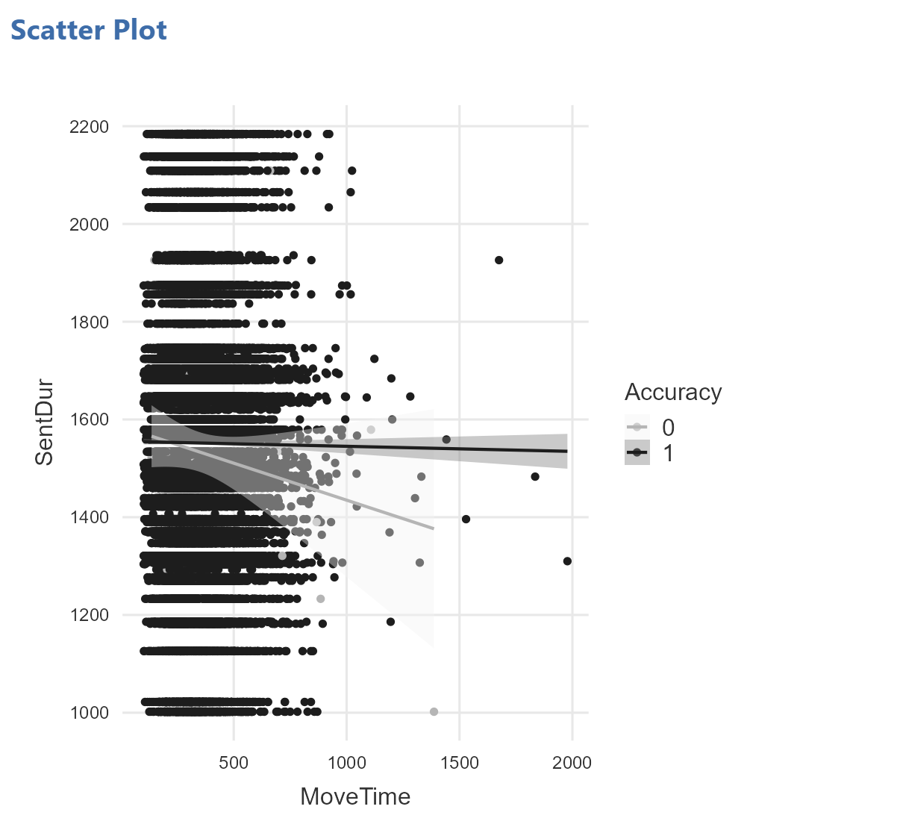
RQ2: Analyses and Results
Analysis: The correlation came to be almost 0, thus not displaying any type of linear relationship between these 2 variables.
Results: r=-0.0055 correlation between move time and sentence duration
Takeaways: The prediction of having quicker move time equaling shorter sentence duration was not consistently proven enough to produce a substantive correlation

Slide 9

Research Question 3:
To what extent do participants' lift-off latency and move time correlate?
Pearson correlation coefficient (r) between participant-level mean lift-off latency and move time (N = 1,278)
Hypothesis:
Prediction:
Separate processing phases are represented by movement execution (move time) and movement initiation (lift-off latency).
There will be little to no association between the two variables since slower commencement times cannot anticipate slower execution times
Notes:
Moving to our third research question, we investigated the relationship between participants lift off latency which is the time it takes to begin a movement and their move time representing the actual physical duration of the movement.
We hypothesized that starting a movement and completing a movement rely on distinct cognitive and motor processes. Therefore, we predicted that the time taken to initiate a response would operate independently of execution speed, showing little to no correlation between the two measures.

Slide 10
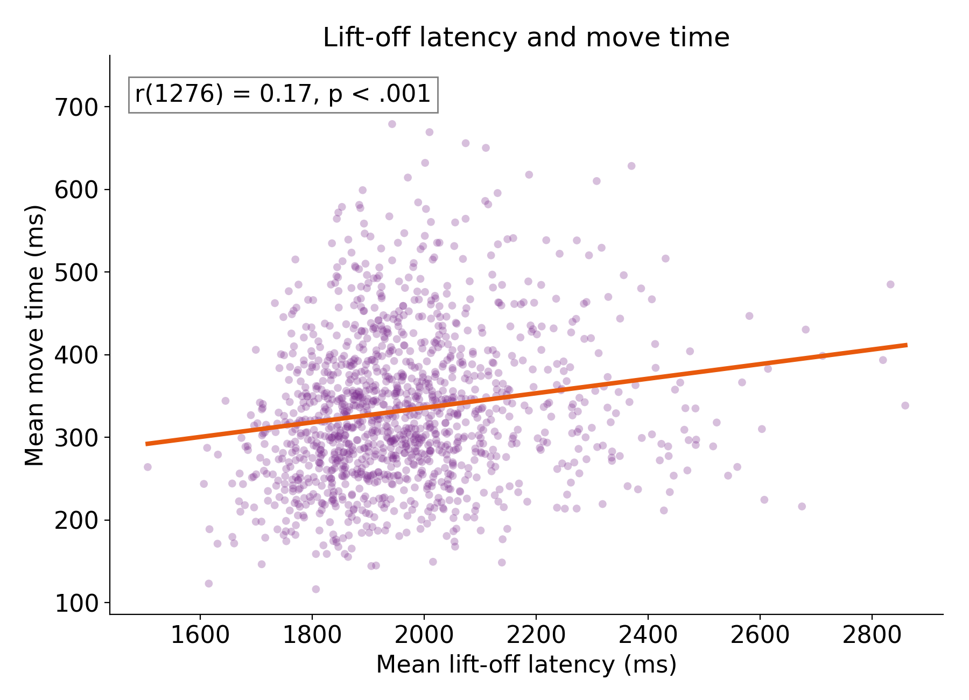
RQ3: Analysis and Results
Statistical Analysis
Key Findings
Because both variables are continuous (measured in milliseconds) and the objective is to assess the degree and direction of the linear association between movement initiation and movement execution among participants (N = 1,278), the Pearson correlation coefficient (r) was selected. ​
Weak, positive, but statistically significant correlation: r(1276) = .17, 95[.11, .22], p < .001​
The two measures share approximately 3% of their variance​
Notes:
To test this question, we chose a Pearson correlation coefficient. We selected this analysis because both of our variables are continuous interval level measures in milliseconds and a correlation allows us to directly evaluate whether participants who take longer to initiate a response also take longer to execute the physical movement.
When running the correlation across our 1,278 participants we found a weak positive but statistically significant relationship: r(1276) = .17 with a 95% confidence interval ranging from .11 to .22 p < .001.
In short while the large sample size makes this correlation statistically significant lift off latency and move time share only about 3% of their variance showing that initiation time and execution time operate largely independently.

Slide 11
Limitations
Trials are not independent
Pooling trials mixes people
None of the variables were manipulated
Trimming shrinks the range
Limited generalizability
Notes:
When it comes to our limitations, the biggest problem with all three concerns is that trials are not independent.
Individual standard errors are probably too tiny and our confidence intervals are too tight because each participant contributed several trials and sentences were heard by many people.
Second, we cannot distinguish between a person being slow overall and one of their specific trials being slow because trials were pooled across individuals.Third, we can only examine correlations and cannot draw any conclusions about causality because none of the factors were changed.
Fourth, cutting off extreme values could cause regression slopes to bend and our associations to diminish.
Lastly, we shouldn't generalize these findings because our sample consists solely of right-handed undergraduates doing a single test.

Slide 12
General Discussion
RQ1: Lift-off latency rose with sentence duration, but less than one-to-one (b = 0.741). The wait after a sentence ends shrinks as sentences get longer, which fits listeners preparing before the sentence finishes.
RQ2: To conclude there was some discrepancy amongst quicker move times and shorter sentence duration, but it was not statistically significant.
RQ3: The conclusion that reaction initiation and response execution qualify different cognitive and motor stages is supported by the fact that lift off delay and move time only shared 3% of their variance, although having a statistically significant positive connection (r(1276) =.17, p <.001)

Slide 13
References
Morey, R. D., Kaschak, M. P., Díez-Álamo, A. M., Glenberg, A. M., Zwaan, R. A., Lakens, D.,Ibáñez, A., García, A., Gianelli, C., Jones, J. L., Madden, J., Alifano, F., Bergen, B.,Bloxsom, N. G., Bub, D. N., Cai, Z. G., Chartier, C. R., Chatterjee, A., Conwell, E., …Ziv-Crispel, N. (2022). A pre-registered, multi-lab non-replication of the action-sentencecompatibility effect (ACE). Psychonomic Bulletin & Review, 29(2), 613–626.https://doi.org/10.3758/s13423-021-01927-8

